Slide 1

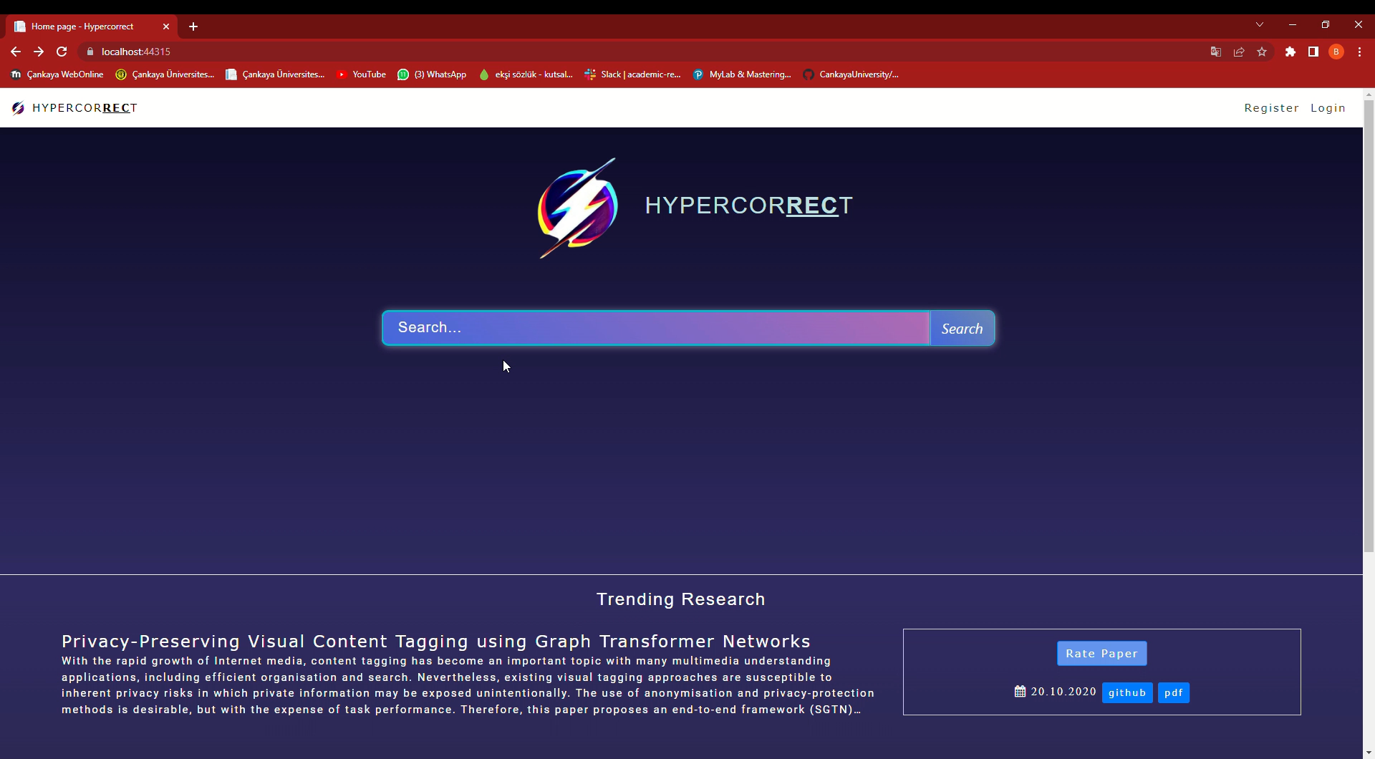

Academic Research Recommender System HYPERCORRECT
Assist. Prof. Dr. Uğur SOPAOĞLU
Anıl Mithatcan AKBAŞ
Başak ÇAVUŞDAĞ
Berkan Taha ÖZDEMİR
Ceren AKKUŞ

Slide 2
Table of contents
01
04
Introduction
Technologies
02
05
Problems
Test Cases
03
06
Solutions
Conclusion

Slide 3
In this project, we developed an academic research recommender system which named as «HYPERCORRECT» The purpose of this project is to recommend papers that may be of interest to the user, as well as the paper search engine.
INTRODUCTION

Slide 4
PROBLEMS
Waste of Time
Information Pollution
Increase the Number of Papers Published
Finding the paper you are looking for can be time consuming.
Due to the widespread use of the Internet.
Unfortunately one of today's problems.

Slide 5
SOLUTIONS
Here are the advantages of HYPERCORRECT:
Hypercorrect allows you to find the article you are looking for in a short time.
Hypercorrect provides some important information about the papers (authors etc.). We will talk about them shortly. Thus, it prevents information pollution.
Due to the widespread use of the internet today, interaction between people has increased in every field. The number of published papers is also increasing day by day.

Slide 6
Technologies

Slide 7










Slide 8
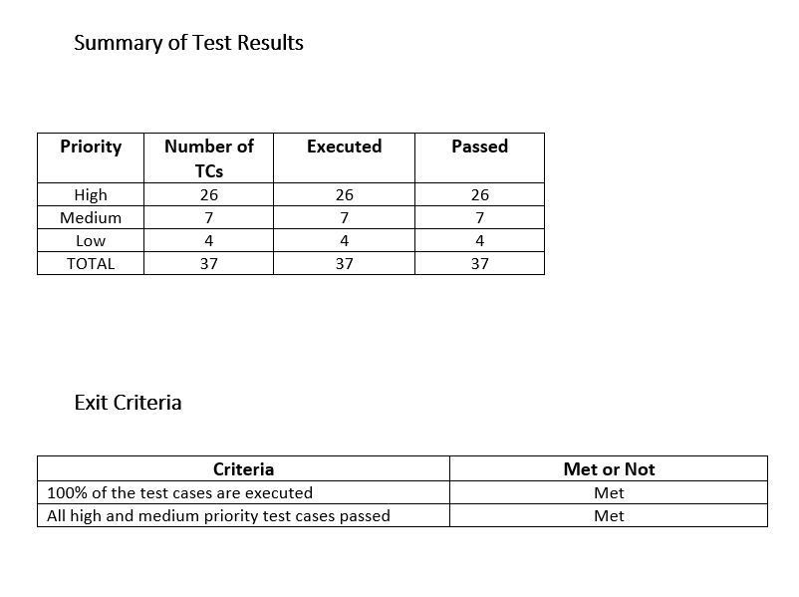
100% PASSED ✔️

Slide 9
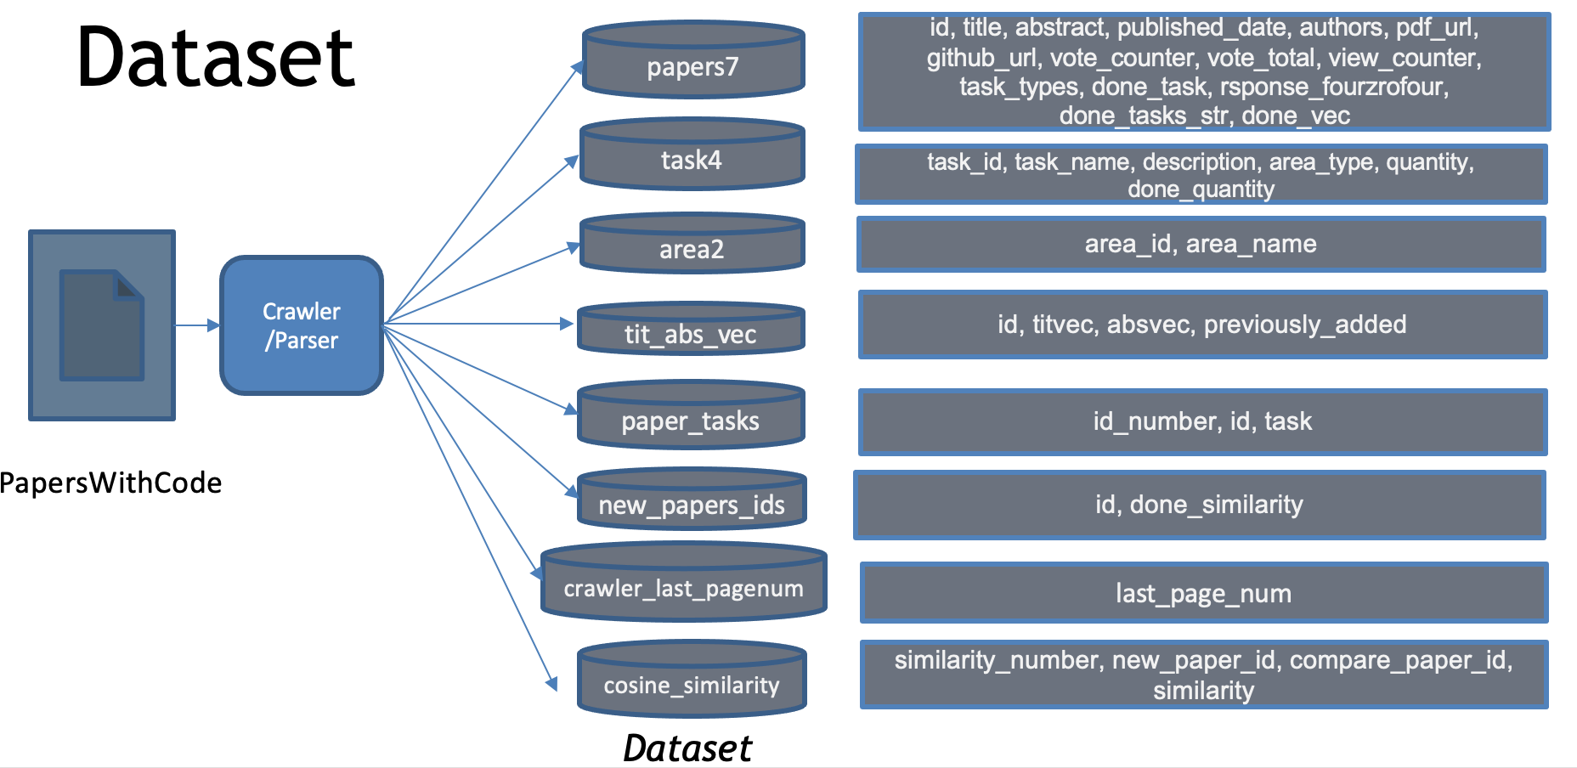

Slide 10
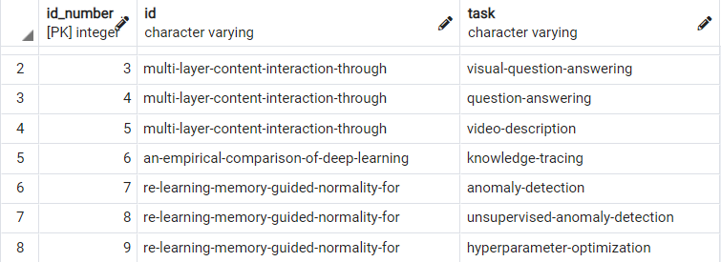
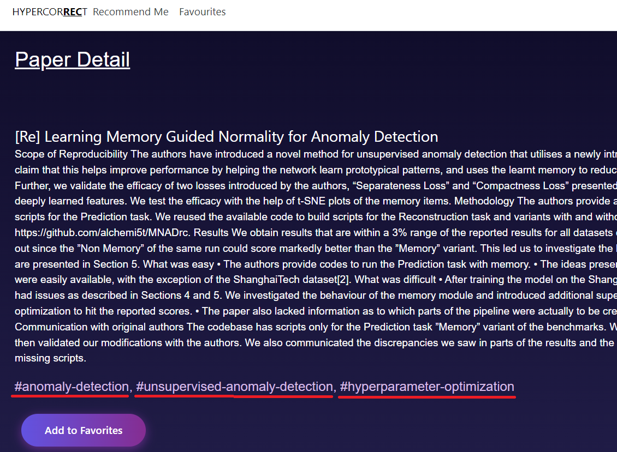
papers_tasks table
A paper could be under multiple tasks
HYPERCORRECT Paper Detail Page

Slide 11
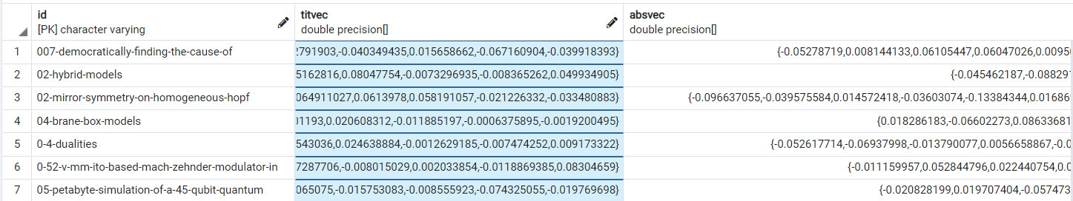
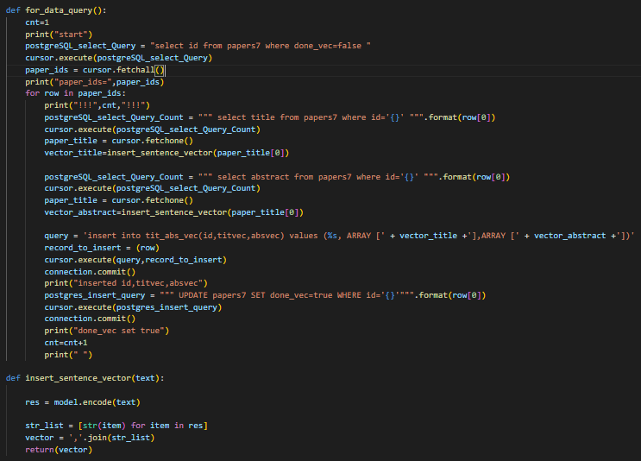
tit_abs_vec table
Contains id of paper, vectors of paper’s title and abstract
Measured using sentence transformer
1. MEASURING VECTORS

Slide 12
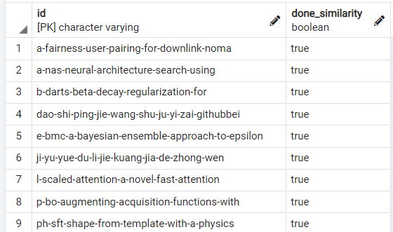
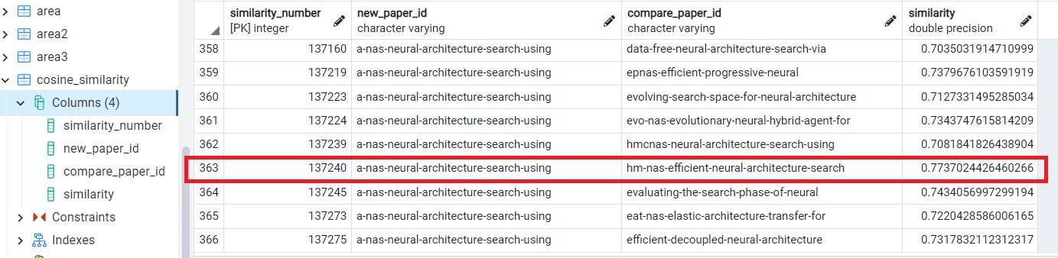
New_papers_ids table
Has the similarity checked with the same task papers using their vectors?
Default false
Instead of comparing vectors with every paper, just compare new paper’s vectors with the same task papers’ vectors !
They both have the same task,
so they get compared
2. MEASURING SIMILARITY
Cosine_similarity table

Slide 13
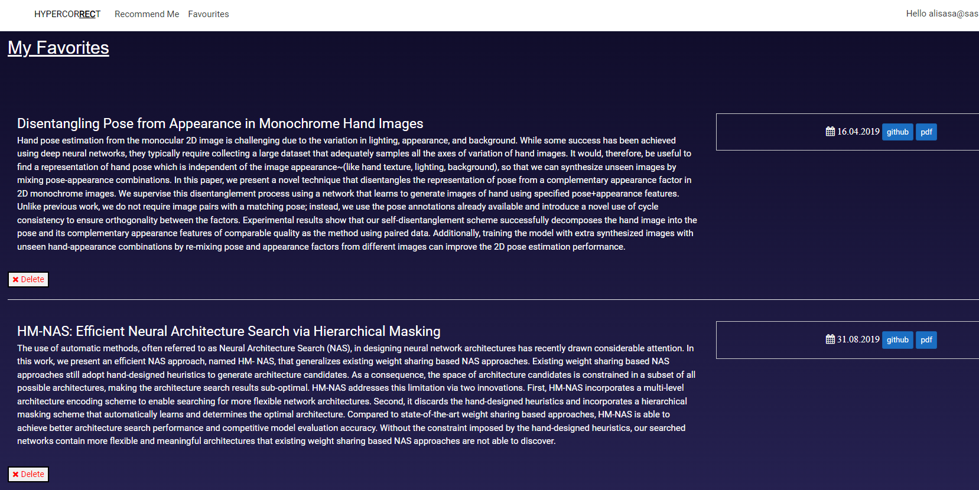
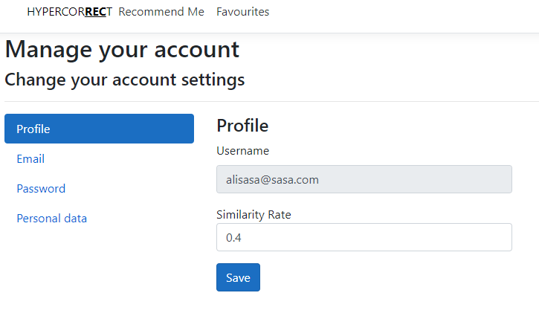
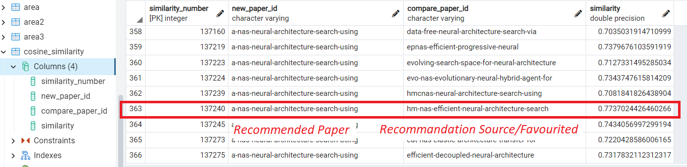
HYPERCORRECT Favourites Page
HYPERCORRECT Profile Page/Setting Similarity Rate
If an user favourites a paper and that paper gets its similarity measured USING COSINE SIMILARITY,
and ALSO has same or bigger similarity rate with new paper,
it gets RECOMMENDED!
3.MAKE RECOMMENDATION
0.7>=0.4
cosine_similarity table

Slide 14
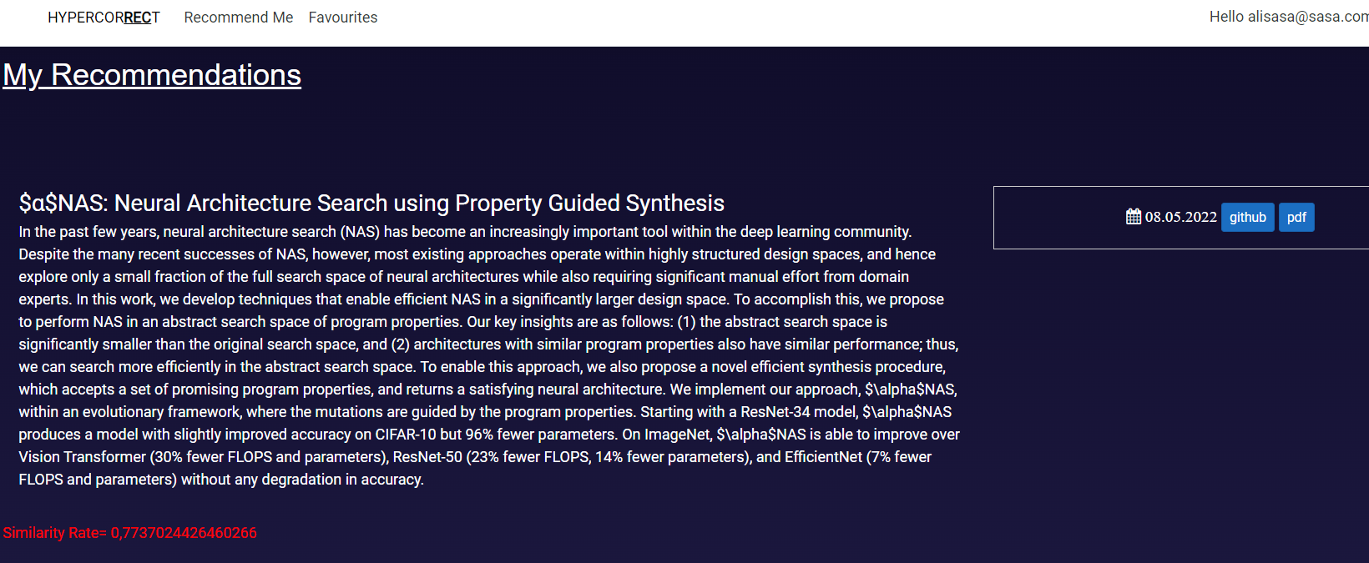
cosine_similarity table
!!!
PAPER GETS RECOMMENDED
!!!

Slide 15
CONCLUSION
Our main goal in this project is to present papers suitable for the user's filters and to recommend papers according to their interests.
We aimed our project to be a solution to the problems we mentioned.

Slide 16
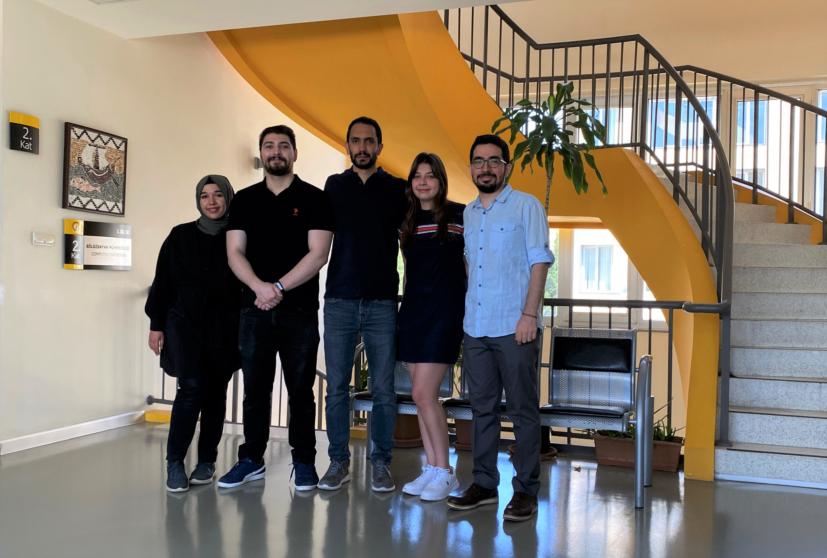


Thanks for Listening

